Slide 1


LU3: Digital Business Models & Ecosystems
Architecting Platform Multi-Sided Dynamics, SaaS Funnels, API Ecosystems, and Enterprise Business Transformation

Slide 2
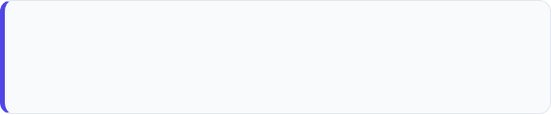

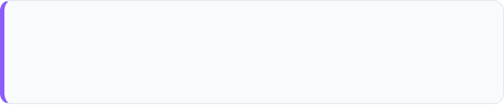

Overall Unit Learning Outcomes
LO1: Multi-Sided Platforms
LO2: Recurring Revenue Structures
Analyze multi-sided platform architecture and two-sided market dynamics in businesses such as Uber, Airbnb, and Amazon.
Evaluate recurring revenue structures including SaaS subscription tiers, freemium conversion funnels, and retention mechanics.
LO3: API-Driven Partner Networks
LO4: Business Model Transformation
Map API-driven partner networks and platform ecosystems that enable cross-industry co-creation of value.
Compare strategic paths between digital-native startups and legacy enterprises undergoing business model transformation.

Slide 3
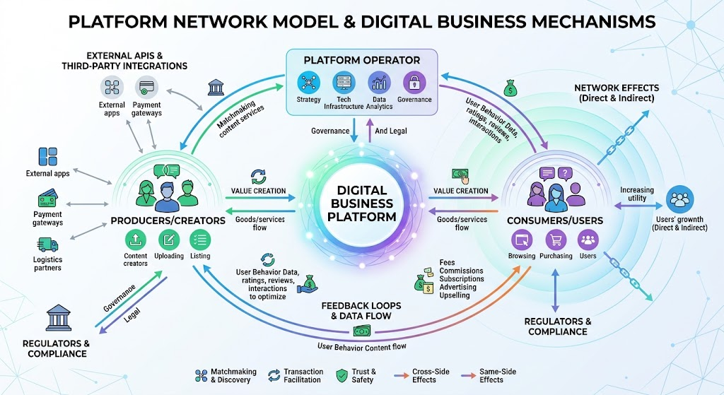
LO1: Multi-Sided Platform Architecture
Two-Sided Market Mechanics: Connecting distinct user groups (buyers & sellers, drivers & riders) to facilitate direct value exchange.
Network Effects: Harnessing positive feedback loops where increased participation on one side directly drives value for the other.
Platform Orchestration: Lowering transaction friction via match-making algorithms, automated pricing, and digital trust mechanics.
Market Champions: Industry benchmarks including Uber (mobility), Airbnb (hospitality), and Amazon Marketplace (e-commerce).

Slide 4









LO1 Activity: Platform Dynamics Workshop
1. Platform Mapping
2. Network Effect Audit
3. Cohort Debrief
Select a legacy business and map out a proposed two-sided marketplace architecture identifying primary producers and consumers.
Identify positive and negative direct/indirect network loops. Formulate rules to solve the chicken-and-egg cold start problem.
Present platform monetization mechanics (take-rates, listing fees, premium matching) to the class for peer evaluation.
Group Breakout
10 Mins
Analysis & Design
15 Mins
Presentation
10 Mins

Slide 5
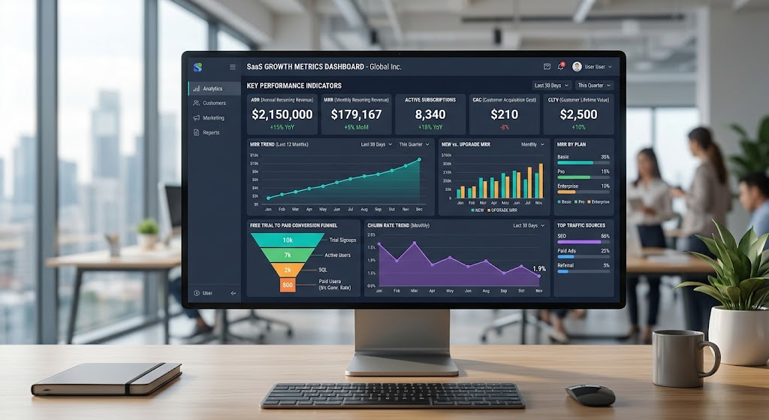
LO2: Recurring Revenue Structures
SaaS Subscription Tiers: Structuring feature-gated plans (Basic, Pro, Enterprise) aligned with value metrics and customer willingness to pay.
Freemium Conversion Funnels: Designing frictionless onboarding triggers that convert free tier users into paying subscribers.
Retention & Unit Economics: Optimizing Customer Acquisition Cost (CAC), Lifetime Value (LTV), and minimizing net revenue churn.
Expansion Revenue: Leveraging usage-based add-ons and seat upgrades to achieve negative net churn growth.

Slide 6









LO2 Activity: SaaS Funnel & Pricing Lab
1. Tier Architecture
2. Funnel Audit
3. Retention Pitch
Design a 3-tier subscription pricing matrix for a B2B SaaS startup, defining value metrics and feature gates.
Analyze a simulated low-conversion freemium funnel and propose targeted product-led growth (PLG) interventions.
Calculate LTV/CAC ratios and pitch a customer retention playbook aimed at reducing annual user churn by 5%.
Matrix Drafting
12 Mins
Case Analysis
13 Mins
Pitch & Feedback
10 Mins

Slide 7


15-Minute Intermission
Take a break, grab a refreshment, and reflect on the platform and recurring revenue strategies discussed so far.
Up Next: API-Driven Partner Ecosystems & Legacy Business Model Transformation

Slide 8
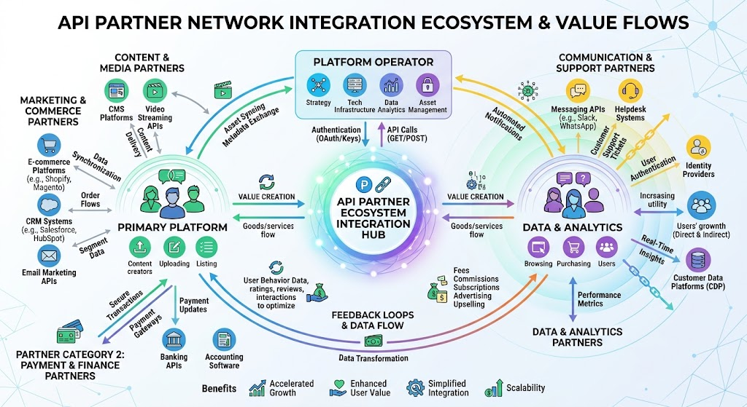
LO3: API Networks & Ecosystems
API as a Business Model: Exposing core capabilities (payments, logistics, data) via APIs to create modular integration hubs.
Partner Ecosystem Networks: Enabling third-party developers to build complementary services on top of core platform infrastructure.
Cross-Industry Co-Creation: Facilitating collaborative value creation across banking, retail, healthcare, and telecom sectors.
Ecosystem Governance: Balancing open access with security, data compliance, and revenue-sharing models.

Slide 9




LO3 Activity: API Ecosystem Mapping
1. API Identification
2. Co-Creation Canvas
3. Ecosystem Pitch
Map out core internal capabilities that can be monetized externally via open or partner-restricted APIs.
Design a cross-industry integration scenario (e.g., Fintech + Healthtech) detailing shared value streams.
Present API partner governance principles and monetization strategies to the peer cohort.
Capability Mapping
10 Mins
Ecosystem Canvas
12 Mins
Cohort Review
8 Mins

Slide 10
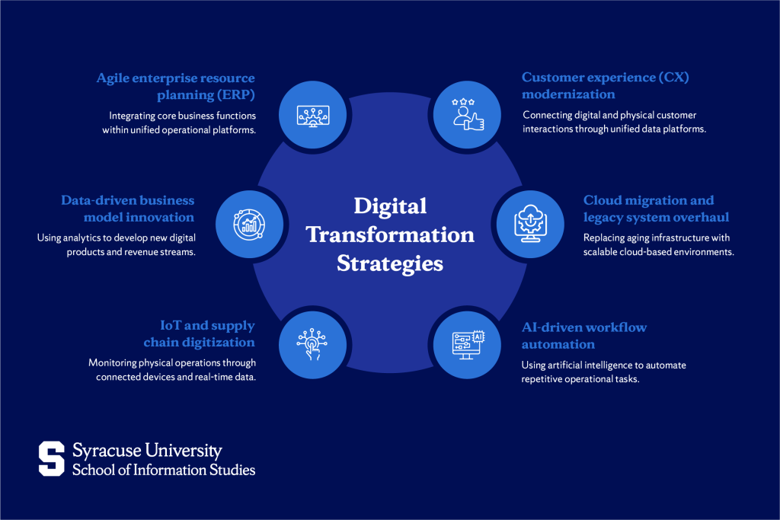
LO4: Business Transformation
Digital-Native vs. Legacy Enterprise
Digital-native startups operate with zero legacy tech debt, agile organizational structures, and product-led growth strategies built for cloud-scale.
In contrast, legacy enterprises undergoing business model transformation face legacy IT infrastructure, cultural inertia, and channel conflict. Success requires ambidextrous innovation—optimizing the core engine while scaling new digital models.

Slide 11



LO4 Activity: Transformation Challenge
1. Legacy Debt Audit
2. Dual-Track Strategy
3. Executive Defense
Assess a traditional enterprise's business model barriers (channel conflict, legacy systems, margin pressure).
Formulate a strategic roadmap balancing core business optimization with new platform/subscription revenue streams.
Defend your business transformation blueprint against board-level objections in a simulated executive review.
Diagnostic Stage
10 Mins
Strategy Drafting
15 Mins
Roleplay & Debate
10 Mins

Slide 12
Questions & Summary
Thank you for participating in LU3: Digital Business Models and Ecosystems.

Slide 13




Image Sources
https://www.slideteam.net/media/catalog/product/cache/1280x720/c/o/conceptual_framework_for_business_digital_transformation_slide01.jpg
Source: www.slideteam.net
https://www.slideteam.net/media/catalog/product/cache/1280x720/s/a/saas_metrics_dashboard_illustrating_revenue_growth_rate_slide01.jpg
Source: www.slideteam.net
https://techafricanews.com/wp-content/uploads/2025/11/API.png
Source: techafricanews.com
https://ischool.syracuse.edu/wp-content/uploads/digital-transformation-business-strategy-1024x683.png
Source: ischool.syracuse.edu

